Slide 1
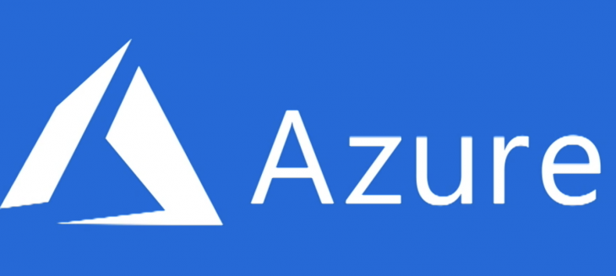
Microsoft Azure Fundamentals

Slide 2
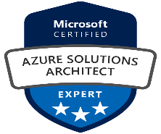
About Myself
Name: V. Harshini
Designation: DevOps Engineer
Team: Group Cloud COE
Experience (Years): 1 year
Expertise: Azure, Azure DevOps
Name: S. Uma
Designation: Cloud Engineer
Team: Group Cloud COE
Experience (Years): 1 year
Expertise: Azure , AWS

Slide 3
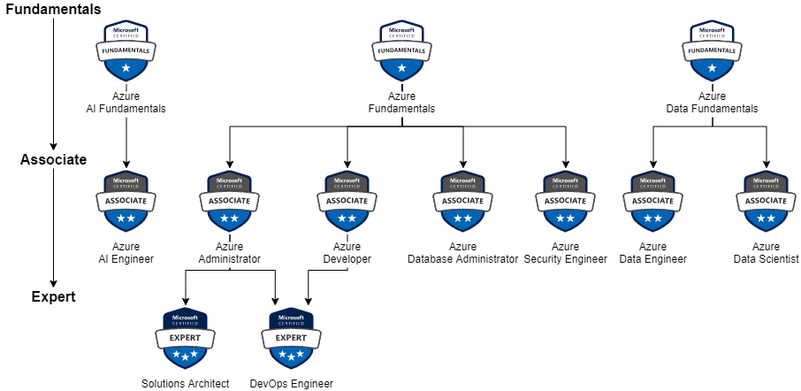
Why Azure Fundamentals AZ-900

Slide 4
Learning Path for Azure Fundamentals
Skills Required & Weightage
Exam
Certification
Cloud Concepts (25-30%)
Azure Management and Governance (30-35%)
AZ-900: Microsoft Azure Fundamentals
Microsoft Certified: Azure Fundamentals
Start Here
Azure Architecture and Services (35-40%)

Slide 5
Module | Topics
1 | Cloud Concepts
2 | Azure Architecture and Services
3 | Azure Management and Governance

Slide 6
1. Cloud Concepts
Cloud Computing
Benefits of using Cloud Services
Cloud Service Types
Notes:
Adjust the title page for AZ-900T00 or AZ-900T01.

Slide 7
1.A. Cloud Computing
Cloud Computing
Shared Responsibility Model
Cloud Models – Public, Private, and Hybrid
Appropriate use cases for each Cloud Models
Consumption-based Model
Cloud Pricing Models
Notes:
Adjust the title page for AZ-900T00 or AZ-900T01.

Slide 8

On-Premise Data Center
Higher Capital Expenditure
Limited Scalability
Unreliability
Higher Maintenance
Higher Operational Expenses
Notes:
What are public, private, and hybrid clouds? - https://azure.microsoft.com/en-us/overview/what-are-private-public-hybrid-clouds/

Slide 9
The ability to rent computing resources - on demand

Slide 10
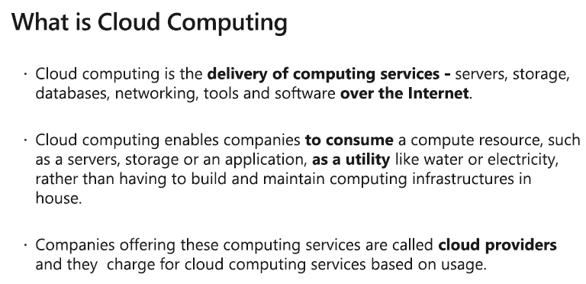
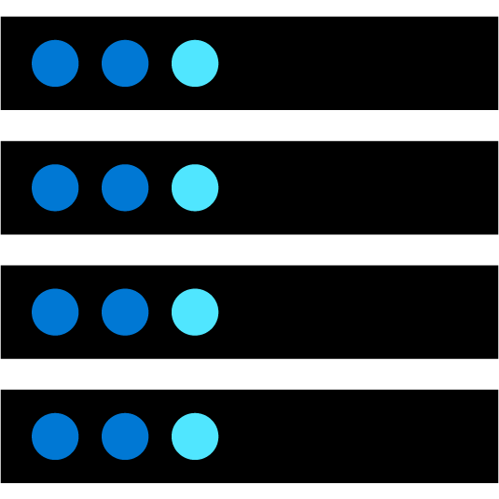

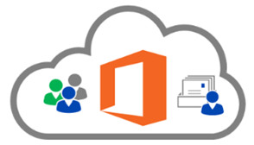
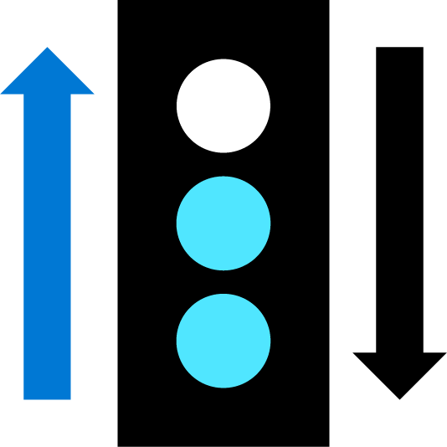

Cloud Computing
Compute
Storage
- such as Window/Linux servers or web applications.
- such as files and databases.
Cloud providers include Microsoft(Azure),
Amazon(AWS),
Google(GCP)
Networking
Analytics
- such as secure connections between the cloud provider and your company
- such as visualizing telemetry and performance data.
Notes:
Cloud computing - https://azure.microsoft.com/en-us/overview/what-is-cloud-computing/
Compute power - such as Linux servers or web applications.
Storage - such as files and databases.
Networking - such as secure connections between the cloud provider and your company.
Analytics - such as visualizing telemetry and performance data.

Slide 11
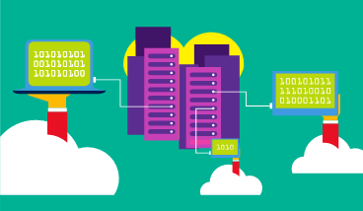
Cloud Models - Public Cloud
Owned by cloud services or hosting provider.
Provides resources and services to multiple organizations and users.
Accessed via secure network connection (typically over the internet).
Notes:
What are public, private, and hybrid clouds? - https://azure.microsoft.com/en-us/overview/what-are-private-public-hybrid-clouds/

Slide 12
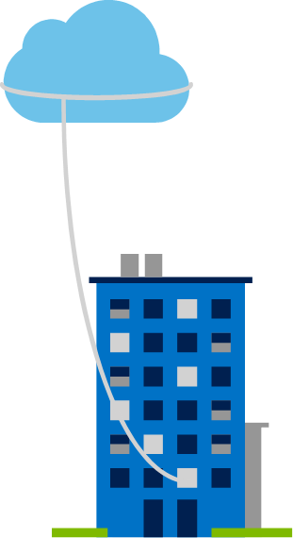
Cloud Models - Private Cloud
Organizations create a cloud environment in their datacenter.
Organizations responsible for operating the services they provide.
Does not provide access to users outside of the organization.
Notes:
Owned and operated by the organization.
Organizations create a cloud environment in their datacenter.
Self-service access to compute resources provided to users within the organization.
Organizations responsible for operating the services they provide.

Slide 13
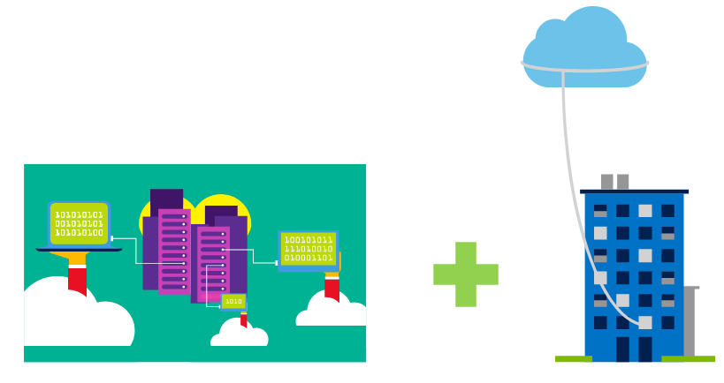
Cloud Models - Hybrid Cloud
Hybrid cloud models have the following characteristics:
Resource location. Specific resources run or are used in a public cloud, and others run or are used in a private cloud.
Cost and efficiency. Hybrid cloud models allow an organization to leverage some of the benefits of cost, efficiency, and scale that are available with a public cloud model.
Control. Organizations retain management control in private clouds.
Skills. Technical skills are still required to maintain the private cloud and ensure both cloud models can operate together.
Combines Public and Private clouds to allow applications to run in the most appropriate location.
Notes:
Hybrid cloud models have the following characteristics:
Resource location. Specific resources run or are used in a public cloud, and others run or are used in a private cloud.
Cost and efficiency. Hybrid cloud models allow an organization to leverage some of the benefits of cost, efficiency, and scale that are available with a public cloud model.
Control. Organizations retain management control in private clouds.
Skills. Technical skills are still required to maintain the private cloud and ensure both cloud models can operate together.

Slide 14
Comparison of Cloud Models
Public cloud:
No capital expenditures to scale up.
Applications can be quickly provisioned and deprovisioned.
Organizations pay only for what they use.
Private cloud:
Hardware must be purchased for start-up and maintenance.
Organizations have complete control over security.
Hybrid cloud:
Provides the most flexibility.
Organizations determine where to run their applications.
Organizations control security, compliance, or legal requirements.
Organizations have complete control over resources.

Slide 15
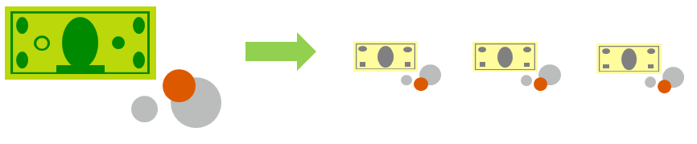
Compare CapEx vs. OpEx
Capital Expenditure (CapEx)
High upfront cost, value of investment reduces over time.
Operational Expenditure (OpEx)
Spend on services or products as needed.
No upfront cost, pay-as-you use.

Slide 16
Consumption-based model
Cloud service providers operate on a consumption-based model, which means that end users only pay for the resources that they use. Whatever they use is what they pay for.
Better cost prediction
Prices for individual resources and services are provided
Billing is based on actual usage
Notes:
This consumption-based model brings with it many benefits, including:
No upfront costs.
No need to purchase and manage costly infrastructure that they may or may not use to its fullest.
The ability to pay for additional resources when they are needed.
The ability to stop paying for resources that are no longer needed.

Slide 17
1.B. Benefits of Cloud
Fault tolerance
High availability
Fault tolerance
Scalability
Elasticity
Global reach
Customer latency capabilities
Agility
Predictive cost considerations
Disaster recovery
Security
Notes:
IaaS, PaaS, and SaaS have dedicated topics, coming up.

Slide 18
1.C. Cloud Services Types
Infrastructure as a Service (IaaS)
Platform as a Service (PaaS)
Software as a Service (SaaS)
Appropriate use cases for each Cloud Service (IaaS, PaaS, SaaS)
Notes:
Adjust the title page for AZ-900T00 or AZ-900T01.

Slide 19
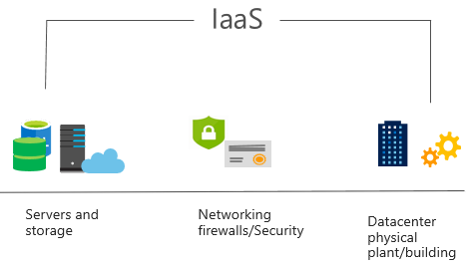
Infrastructure as a Service (IaaS)
Build pay-as-you-go IT infrastructure by renting servers, virtual machines, storage, networks, and operating systems from a cloud provider.
IaaS is the most basic category of cloud computing services.
With IaaS, you rent IT infrastructure servers, and virtual machines (VMs),storage, networks, and operating systems from a cloud provider on a pay-as-you-go basis. It's an instant computing infrastructure, provisioned and managed over the internet.
Notes:
For more information on IaaS, visit https://azure.microsoft.com/en-us/overview/what-is-iaas/
Most basic cloud computing services category.
Build pay-as-you-go IT infrastructure by renting servers, virtual machines, storage, networks, and operating systems from a cloud provider.
Instant computing infrastructure, provisioned and managed over the internet.

Slide 20
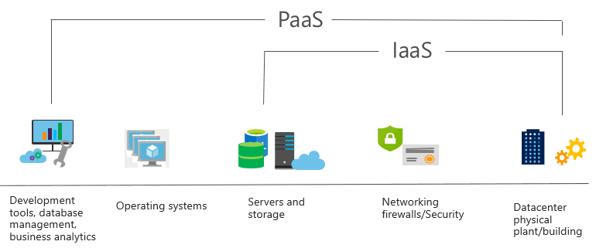
Platform as a Service (PaaS)
PaaS provides an environment for building, testing, and deploying software applications. The goal of PaaS is to help create an application as quickly as possible without having to focus on managing the underlying infrastructure.
Notes:
For more information on PaaS, see https://azure.microsoft.com/en-us/overview/what-is-paas/
Provides environment for building, testing, and deploying software applications.
Helps create applications quickly, without focusing on managing underlying infrastructure.

Slide 21
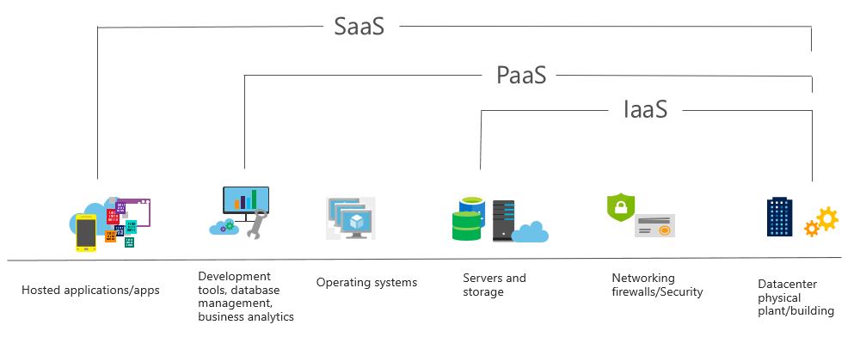
Software as a Service (SaaS)
Users connect to and use cloud-based apps over the internet: for example, Microsoft Office 365, email, and calendars.
SaaS is software that is centrally hosted and managed for the end customer. It allows users to connect to and use cloud-based apps over the internet. Common examples are email, calendars, and office tools such as Microsoft Office 365.
Notes:
Common usage scenarios:
Examples of Microsoft SaaS services include Microsoft Office 365, Skype, and Microsoft Dynamics CRM Online.
For more information on SaaS, see https://azure.microsoft.com/en-us/overview/what-is-saas/

Slide 22
Compare Cloud Services Types
IaaS
PaaS
SaaS
The most flexible cloud service.
You configure and manage the hardware for your application.
Focus on application development.
Platform management is handled by the cloud provider.
Pay-as-you-go pricing model.
Users pay for the software they use on a subscription model.
Notes:
The slide contains only some of the cloud service comparison discussion points.

Slide 23
Shared Responsibility Model
On-Premises
( Private Cloud )
Infrastructure
( as a Service )
Platform
( as a Service )
Software
( as a Service )
IaaS requires the most user management of all the cloud services. The user is responsible for managing the operating systems, data, and applications.
PaaS requires less user management. The cloud provider manages the operating systems, and the user is responsible for the applications and data they run and store.
SaaS requires the least amount of management. The cloud provider is responsible for managing everything, and the end user just uses the software.
Data & Access
Data & Access
Data & Access
Data & Access
Applications
Applications
Applications
Applications
You Manage
Runtime
Runtime
Runtime
Runtime
Cloud Provider Manages
Operating System
Operating System
Operating System
Operating System
Virtual Machine
Virtual Machine
Virtual Machine
Virtual Machine
Compute
Compute
Compute
Compute
Networking
Networking
Networking
Networking
Storage
Storage
Storage
Storage
Notes:
IaaS, PaaS, and SaaS have dedicated topics, coming up.

Slide 24
2.A. Core Architectural Components of Azure
Regions and Region Pairs
Availability Zones
Azure Datacenters
Azure Resources & Resource Groups
Subscriptions
Azure Management Groups
Hierarchy of resource groups, subscriptions, and management groups

Slide 25
Geographies
Discrete markets that preserve data residency and compliance boundaries.
Typically contain two or more regions.
Allow customers with specific data-residency and compliance needs to keep their data and applications in close proximity.
Categorized as Americas, Europe, Asia Pacific, Middle East, and Africa.
Notes:
A list of geography locations is available at : https://azure.microsoft.com/en-us/global-infrastructure/geographies/

Slide 26
Regions
A region represents a collection of datacenters.
Provides flexibility and scale.
Preserves data residency.
Select regions close to your users.
Be aware of region deployment availability.
There are global services that are region independent.
Worldwide there are 54 regions representing 140 countries
Notes:
A list of regions and their locations is available at https://azure.microsoft.com/en-us/global-infrastructure/locations/

Slide 27
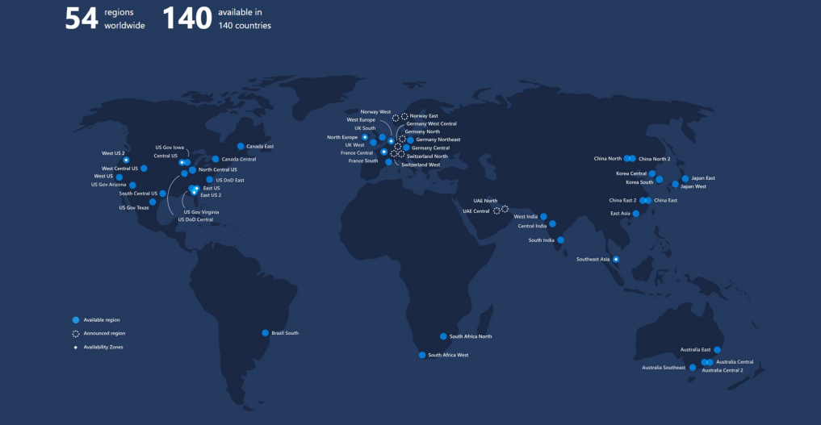

Slide 28
Region Pairs
Each Azure region is paired with another region.
Azure prefers at least 300 miles of separation between datacenters in a regional pair.
Some services provide automatic replication to the paired region.
In an outage, recovery of one region is prioritized out of every pair.
Azure system updates are rolled out to paired regions sequentially (not at the same time).
Paired regions are members of the same geography – except Brazil.
Region
North Central US​
East US​
West US 2​
US East 2​
Canada Central​
North Europe​
UK West​
Germany Central​
South East Asia​
East China​
Japan East​
Australia Southeast​
India South​
Brazil South (Primary)​
Region
South Central US​
West US​
West Central US​
Central US​
Canada East​
West Europe​
UK South​
Germany Northeast​
East Asia​
North China​
Japan West​
Australia East​
India Central​
South Central US ​
Notes:
A full list of region pairs is available at https://docs.microsoft.com/en-us/azure/best-practices-availability-paired-regions#what-are-paired-regions

Slide 29
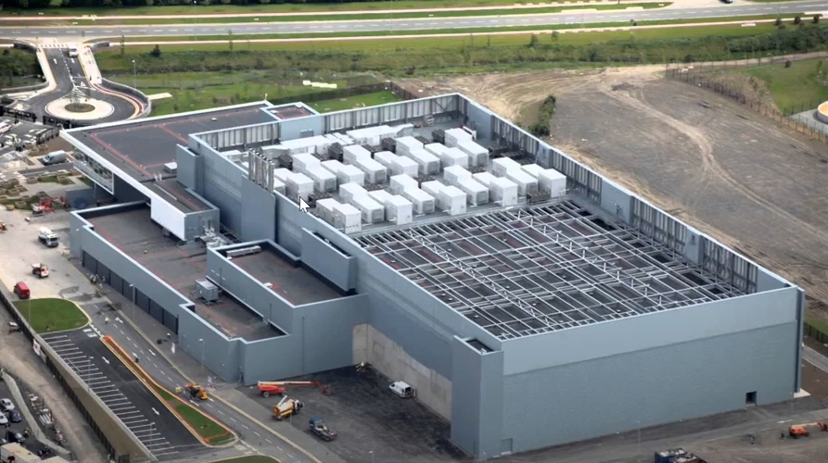
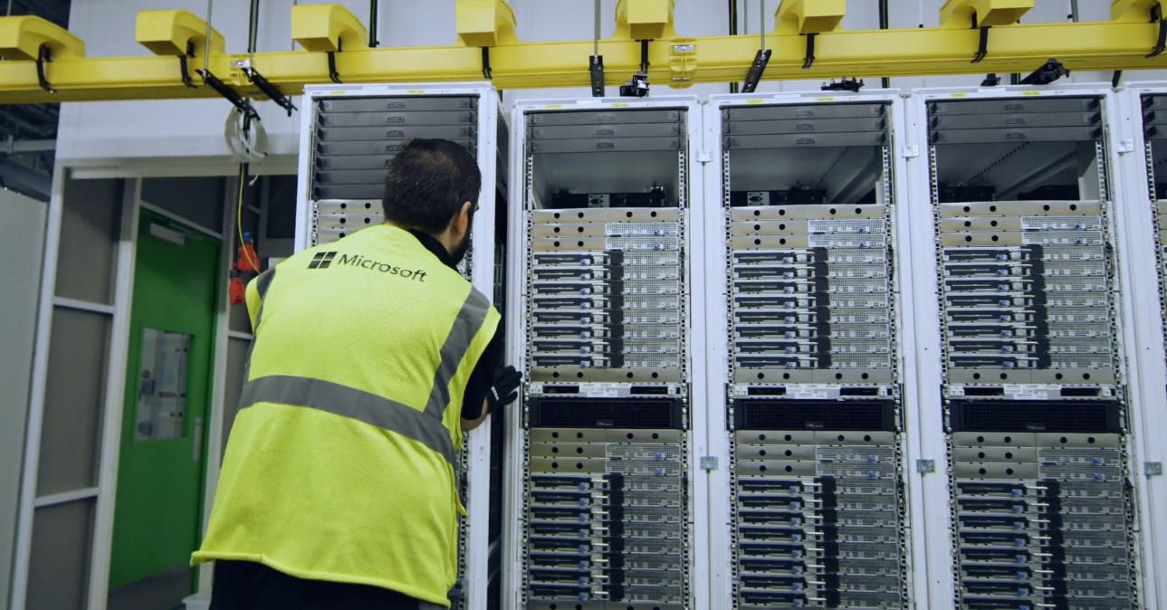
Datacenter
Server Rack

Slide 30
Availability Options
VM SLA
VM SLA
VM SLA
MULTI-REGION DISASTER RECOVERY
99.9% with Premium Storage
99.95%
99.99%
Region 1
Region 2
SINGLE VM
AVAILABILITY SETS
AVAILABILITY ZONES
REGION PAIRS
Easier lift and shift
Protecting against failures within datacenters
Protection from entire datacenter failures
Regional protection within Data Residency Boundaries
Notes:
This slide is to introduce the upcoming topics. You could also use the slide at the end of the lesson to review.

Slide 31






Azure Resources
Azure resources are components like storage, virtual machines, and networks that are available to build cloud solutions.
Virtual Machines
Storage Accounts
Virtual Networks
App Services
SQL Databases
Functions
Notes:
Learn and SkillPipe content order note:
Slides 11-13
https://docs.microsoft.com/en-us/learn/modules/azure-architecture-fundamentals/resources-resource-manager

Slide 32
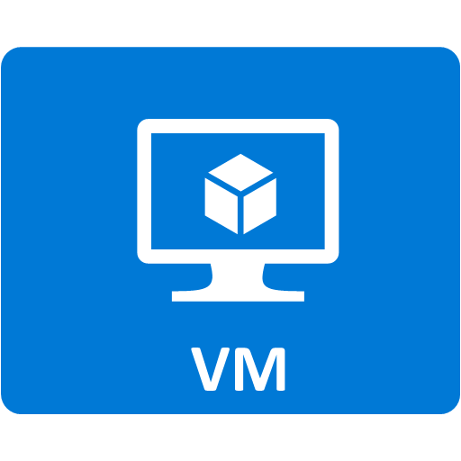


Resource groups
Resource groups (web + DB, VM, Storage) in one group
Containers for multiple resources that share the same life cycle.
Aggregates resources into a single manageable unit.
Every Azure resource must exist in one (and only one) resource group.
Secure at the resource group (or resource) level - using role-based access control (RBAC).
OR
Web and DB resource group
Virtual machine resource group
Storage resource group

Slide 33
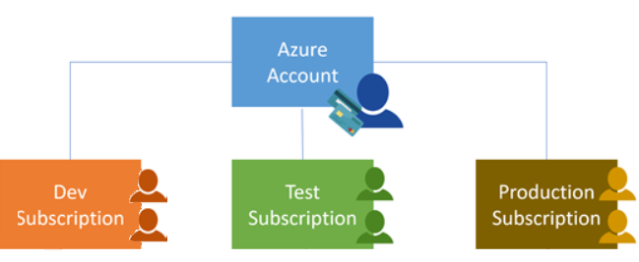
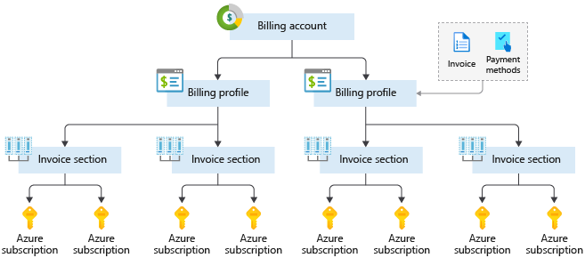
Azure Subscriptions
An Azure subscription provides you with authenticated and authorized access to Azure accounts.
Billing boundary: generate separate billing reports and invoices for each subscription.
Access control boundary: manage and control access to the resources that users can provision with specific subscriptions.
Notes:
An account can have one subscription or multiple subscriptions.
Azure subscription offers - https://azure.microsoft.com/en-us/support/legal/offer-details/
Learn and SkillPipe content order note:
Slides 14 & 16
https://docs.microsoft.com/en-us/learn/modules/azure-architecture-fundamentals/management-groups-subscriptions

Slide 34
Azure Services
Compute
Networking
Storage
Mobile
Databases
Web
Internet of Things (IoT)
Big data
AI
DevOps

Slide 35
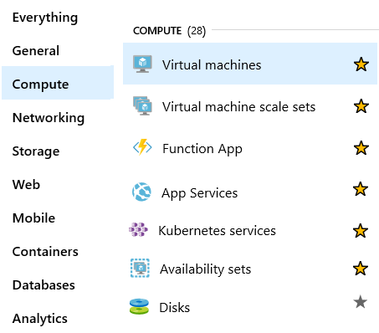
Azure Compute Services
On-demand computing service for running cloud-based applications.
Provides computing resources such as disks, processors, memory, networking, and operating systems.
Makes resources available in minutes or seconds.
Lots of on-demand services.
Pay-per-use.
Notes:
For a full list of compute services available with Azure and the context on when to use them, visit https://azure.microsoft.com/en-us/product-categories/compute/

Slide 36

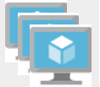

Azure Compute Services
Azure VMs use Infrastructure as a Service (IaaS) to provide computing power in the cloud.
VM Scale Sets are designed for the automatic scaling of identical VMs.
App Services is a Platform as a Service (PaaS) offering to build, deploy, and scale enterprise-grade web, mobile, and API apps.
Functions perform compute actions based on an event.
Notes:
Azure virtual machines - https://azure.microsoft.com/en-us/services/virtual-machines/
Virtual machine scale sets - https://azure.microsoft.com/en-us/services/virtual-machine-scale-sets/
App services - https://azure.microsoft.com/en-us/services/app-service/
Azure Functions - https://azure.microsoft.com/en-us/services/functions/

Slide 37


Azure Compute Services
Azure Container Instances: a PaaS offering that runs a container in Azure without the need to manage a virtual machine or additional services.
Azure Kubernetes Service: an orchestration service for containers with distributed architectures and large volumes of containers.
Notes:
Azure virtual machines - https://azure.microsoft.com/en-us/services/virtual-machines/
Virtual machine scale sets - https://azure.microsoft.com/en-us/services/virtual-machine-scale-sets/
App services - https://azure.microsoft.com/en-us/services/app-service/
Azure Functions - https://azure.microsoft.com/en-us/services/functions/

Slide 38
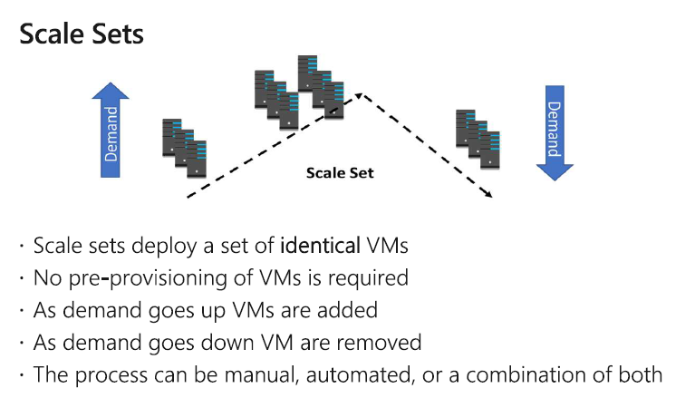
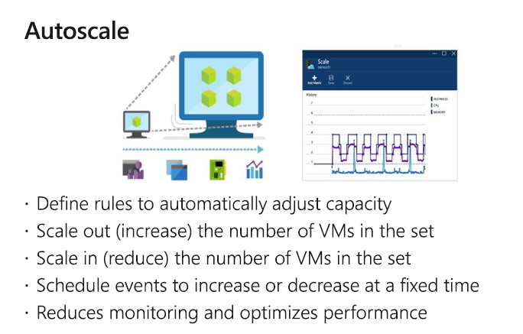

Slide 39



Azure Network Services
Azure Virtual Network enables Azure resources to communicate with each other, the internet and on-premises networks.
Subnet is a range of IP addresses in the virtual network. You can divide a virtual network into multiple subnets for organization and security. Each NIC in a VM is connected to one subnet in one virtual network.
Azure Load Balancer automatically scales to create highly-available access to applications or resources.
Notes:
Virtual Networks - https://azure.microsoft.com/en-us/services/virtual-network/
Azure Load Balancer - https://azure.microsoft.com/en-us/services/load-balancer/
VPN gateway - https://azure.microsoft.com/en-us/services/vpn-gateway/
Azure Application Gateway - https://azure.microsoft.com/en-us/services/application-gateway/
Content Delivery Network - https://azure.microsoft.com/en-us/services/cdn/
Networking - https://azure.microsoft.com/en-us/product-categories/networking/

Slide 40



Azure Network Services
VPN Gateway is used to send encrypted traffic between an Azure virtual network and an on-premises location over the public internet.
Azure Express Route extends on-premises networks into Azure over a private connection that is facilitated by a connectivity provider.
Content Delivery Network provides a distributed network of servers that efficiently deliver web content in their local region.
Notes:
Virtual Networks - https://azure.microsoft.com/en-us/services/virtual-network/
Azure Load Balancer - https://azure.microsoft.com/en-us/services/load-balancer/
VPN gateway - https://azure.microsoft.com/en-us/services/vpn-gateway/
Azure Application Gateway - https://azure.microsoft.com/en-us/services/application-gateway/
Content Delivery Network - https://azure.microsoft.com/en-us/services/cdn/
Networking - https://azure.microsoft.com/en-us/product-categories/networking/

Slide 41
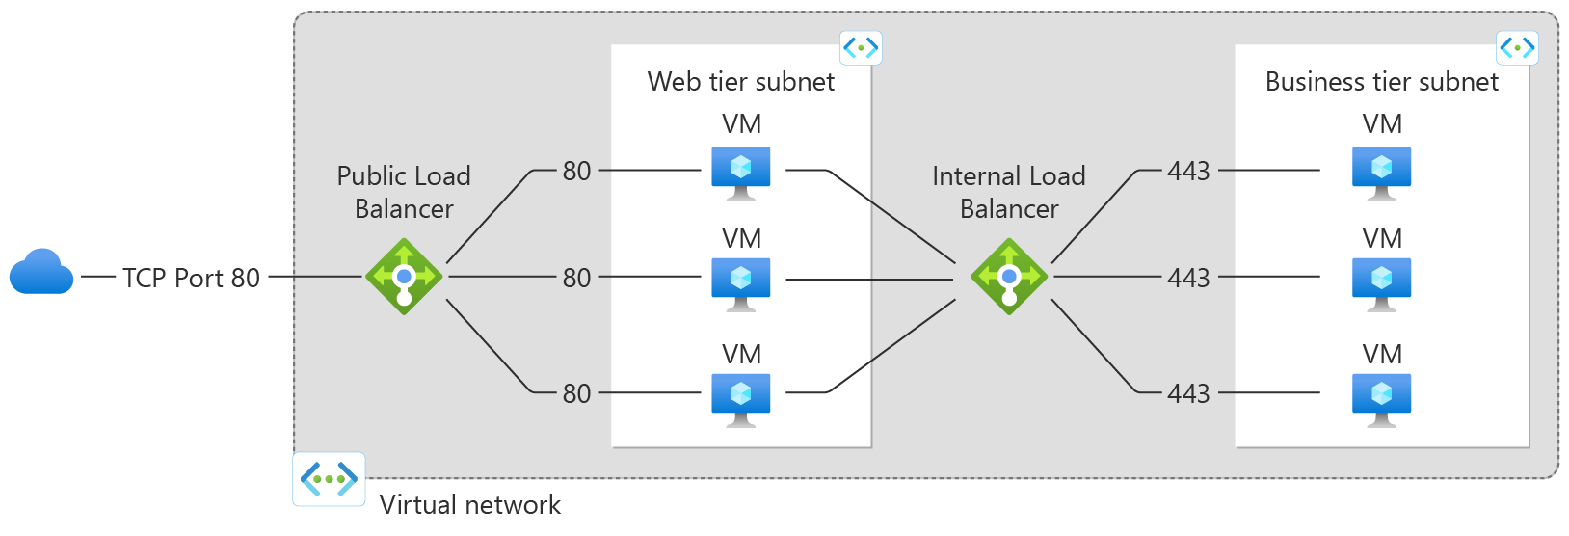
Azure Load Balancer
Notes:
Virtual Networks - https://azure.microsoft.com/en-us/services/virtual-network/
Azure Load Balancer - https://azure.microsoft.com/en-us/services/load-balancer/
VPN gateway - https://azure.microsoft.com/en-us/services/vpn-gateway/
Azure Application Gateway - https://azure.microsoft.com/en-us/services/application-gateway/
Content Delivery Network - https://azure.microsoft.com/en-us/services/cdn/
Networking - https://azure.microsoft.com/en-us/product-categories/networking/

Slide 42
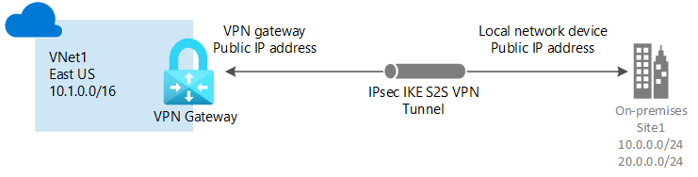
Azure VPN Gateway
Notes:
Virtual Networks - https://azure.microsoft.com/en-us/services/virtual-network/
Azure Load Balancer - https://azure.microsoft.com/en-us/services/load-balancer/
VPN gateway - https://azure.microsoft.com/en-us/services/vpn-gateway/
Azure Application Gateway - https://azure.microsoft.com/en-us/services/application-gateway/
Content Delivery Network - https://azure.microsoft.com/en-us/services/cdn/
Networking - https://azure.microsoft.com/en-us/product-categories/networking/

Slide 43
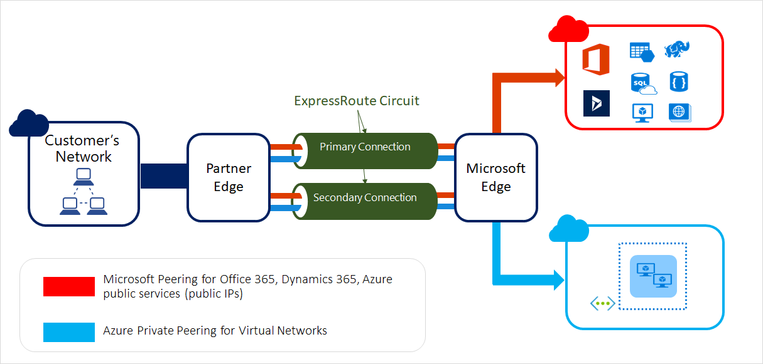
Azure Express Route
Notes:
Virtual Networks - https://azure.microsoft.com/en-us/services/virtual-network/
Azure Load Balancer - https://azure.microsoft.com/en-us/services/load-balancer/
VPN gateway - https://azure.microsoft.com/en-us/services/vpn-gateway/
Azure Application Gateway - https://azure.microsoft.com/en-us/services/application-gateway/
Content Delivery Network - https://azure.microsoft.com/en-us/services/cdn/
Networking - https://azure.microsoft.com/en-us/product-categories/networking/

Slide 44
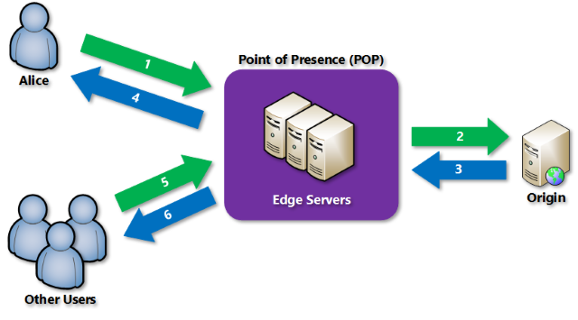
Azure Content Delivery Network (CDN)
Notes:
Virtual Networks - https://azure.microsoft.com/en-us/services/virtual-network/
Azure Load Balancer - https://azure.microsoft.com/en-us/services/load-balancer/
VPN gateway - https://azure.microsoft.com/en-us/services/vpn-gateway/
Azure Application Gateway - https://azure.microsoft.com/en-us/services/application-gateway/
Content Delivery Network - https://azure.microsoft.com/en-us/services/cdn/
Networking - https://azure.microsoft.com/en-us/product-categories/networking/

Slide 45
2.C. Azure Storage Services
Compare Azure Storage Services
Storage Tiers
Redundancy Options
Storage Account Options & Storage Types
Options for Moving Files, including AzCopy, Azure Storage Explorer and Azure File Sync
Migration Options, including Azure Migrate and Azure Data Box

Slide 46
Azure Storage
A service that you can use to store files, messages, tables, and other types of information
A service that you can use to store files, messages, tables, and other types of information
Durable, secure, scalable, managed, accessible
Durable, secure, scalable, managed, accessible
Premium and Standard
Storage for virtual machines, unstructured data and structured data
Two tiers: Premium and Standard
Storage for virtual machines, unstructured data and structured data

Slide 47
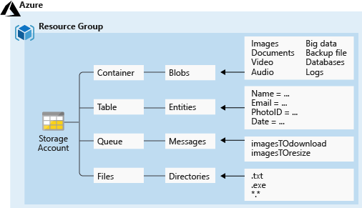
Azure Storage Services
Azure Containers: A massively scalable object store for text and binary data
Azure Tables: Ideal for storing structured, non-relational data
Azure Queues: A messaging store for reliable messaging between application components
Azure Files: Managed file shares for cloud or on-premises deployments

Slide 48
Access Storage
Every object has a unique URL address – based on account name and storage type
Container service: https://mystorageaccount.blob.core.windows.net
Table service: https://mystorageaccount.table.core.windows.net
Queue service: https://mystorageaccount.queue.core.windows.net
File service: https://mystorageaccount.file.core.windows.net
If you prefer you can configure a custom domain name
CNAME record | Target
blobs.contoso.com | contosoblobs.blob.core.windows.net

Slide 49
Azure Storage Access Tiers
Hot | Cool | Archive
Optimized for storing data that is accessed frequently. | Optimized for storing data that is infrequently accessed and stored for at least 30 days. | Optimized for storing data that is rarely accessed and stored for at least 180 days with flexible latency requirements.
You can switch between these access tiers at any time.

Slide 50
Storage Account Kinds
Storage Account | Recommended usage
Standard general-purpose v2 | Most scenarios including Blob, File, Queue, Table etc..
Premium block blobs | Block blob scenarios with high transaction rates, or scenarios that use smaller objects or require consistently low storage latency.
Premium file shares | Enterprise or high-performance file share applications.
Premium page blobs | Premium high-performance page blob scenarios.
✓
All storage accounts are encrypted using Storage Service Encryption (SSE) for data at rest

Slide 51
Redundancy Options (1 of 2)
Single region
Multiple regions
Typically, >300mi
Typically, >300mi
Z1
Async
Async
Z2
Z3
Primary
Secondary
Primary
Secondary
LRS
Three replicas, one region
Protects against disk, node, rack failures
Write is acknowledged when all replicas are committed
Superior to dual-parity RAID
ZRS
Three replicas, three zones, one region
Protects against disk, node, rack, and zone failures
Synchronous writes to all three zones
GRS
Six replicas, two regions (three per region)
Protects against major regional disasters
Asynchronous copy to secondary
RA-GRS
GRS + read access to secondary
Separate secondary endpoint
Recovery point objective (RPO) delay to secondary can be queried
Continued next slide

Slide 52
Redundancy Options (2 of 2)
Multiple regions
Typically, >300mi
Typically, >300mi
Z1
Z1
Secondary
Secondary
Z2
Z3
Z2
Z3
Async
Async Read
GZRS
Six replicas, 3+1 zones, two regions
Protects against disk, node, rack, zone, and region failures
Synchronous writes to all three zones and asynchronous copy to secondary
RA-GZRS
GZRS + read access to secondary
Separate secondary endpoint
RPO delay to secondary can be queried
Continued next slide

Slide 53
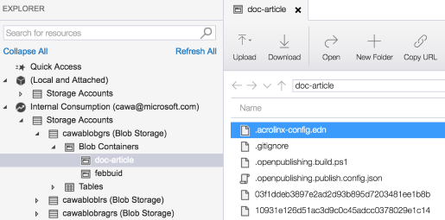
Azure Storage Explorer
Access multiple accounts and subscriptions
Create, delete, view, edit storage resources
View and edit Blob, Queue, Table, File, Cosmos DB storage and Data Lake Storage
Obtain shared access signature (SAS) keys
Available for Windows, Mac, and Linux

Slide 54
2.D. Azure Identity, Access, and Security
Azure AD & Azure AD DS
Authentication Methods including SSO, MFA & Passwordless
Conditional Access
Azure Role-Based Access Control (RBAC)
Concept of Zero Trust
Defense in Depth Model
Microsoft Defender for Cloud

Slide 55

Azure Active Directory (AAD)
Azure Active Directory (AAD) is Microsoft Azure’s cloud-based identity and access management service.
Authentication (employees sign-in to access resources).
Single sign-on (SSO).
Application management.
Business to Business (B2B).
Business to Customer (B2C) identity services.
Device management.

Slide 56



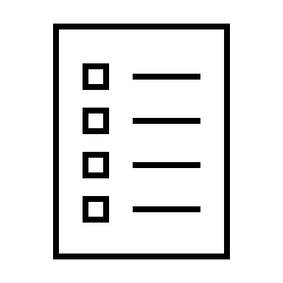





Compare Authentication and Authorization
Authentication Identifies the person or service seeking access to a resource.
Requests legitimate access credentials.
Basis for creating secure identity and access control principles.
Authorization Determines an authenticated person’s or service’s level of access.
Defines which data they can access, and what they can do with it.
Who are you?
What you are allowed to do?

Slide 57
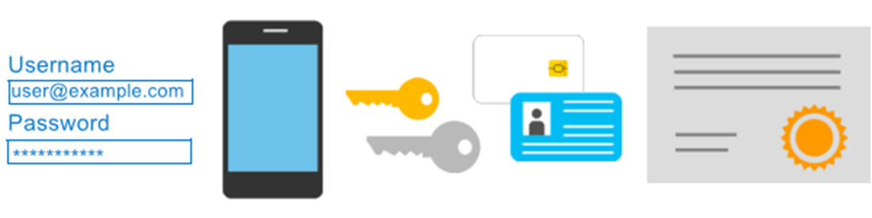
Azure Multi-Factor Authentication
Provides additional security for your identities by requiring two or more elements for full authentication.
Something you know ←→ Something you possess ←→ Something you are

Slide 58
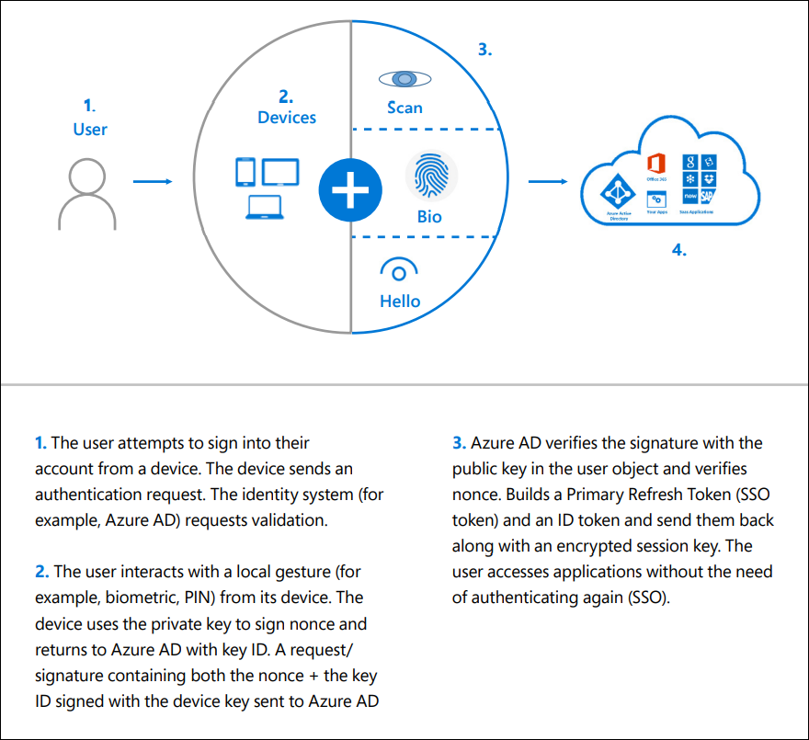
Passwordless

Slide 59
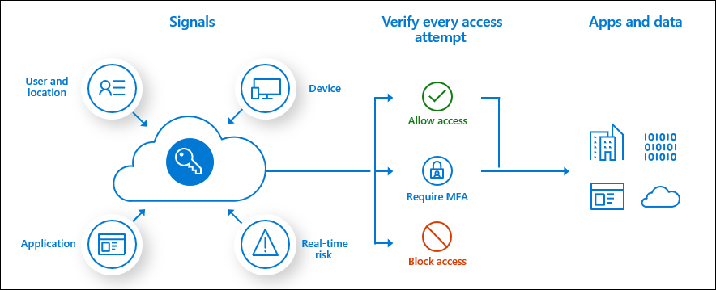
Conditional Access
Conditional Access is used by Azure Active Directory to bring signals together, to make decisions, and enforce organizational policies.
User or Group Membership
IP Location
Device
Application
Risk Detection

Slide 60
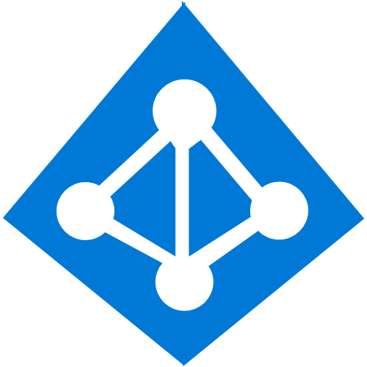



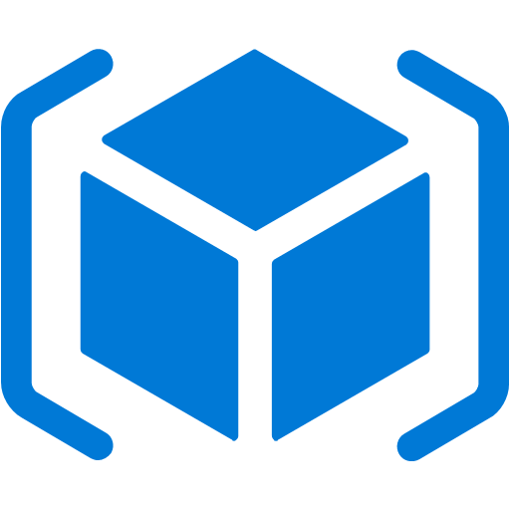
Azure Role-Based Access Control (RBAC)
Fine-grained access management.
Segregate duties within the team and grant only the amount of access to users that they need to perform their jobs.
Enables access to the Azure portal and controlling access to resources.
Azure
Active Directory
Azure
subscription
User
Apps
User groups
Resource group
Resource group

Slide 61
Defense in Depth Model
Physical Security
A layered approach to securing computer systems.
Provides multiple levels of protection.
Attacks against one layer are isolated from subsequent layers.
Identity & Access
Perimeter
Network
Compute
Application
Data

Slide 62
Shared Security
Responsibility | On-Premises | IaaS | PaaS | SaaS
Data governance and Rights Management | Customer | Customer | Customer | Customer
Client endpoints | Customer | Customer | Customer | Customer
Account and access management | Customer | Customer | Customer | Customer
Identity and directory infrastructure | Customer | Customer | Microsoft/ Customer | Microsoft/ Customer
Application | Customer | Customer | Microsoft/ Customer | Microsoft
Network controls | Customer | Customer | Microsoft/ Customer | Microsoft
Operating system | Customer | Customer | Microsoft | Microsoft
Physical hosts | Customer | Microsoft | Microsoft | Microsoft
Physical network | Customer | Microsoft | Microsoft | Microsoft
Physical datacenter | Customer | Microsoft | Microsoft | Microsoft
Migrating from customer-controlled to cloud-based datacenters shifts the responsibility for security.
Security becomes a shared concern between cloud providers and customers.

Slide 63
3. Azure Management and Governance
Cost Management
Tools for Governance and Compliance Compute and Networking Services
Tools for Managing and Deploying Azure Resources
Monitoring Tools

Slide 64
3.A. Cost Management
Factors affecting Costs
Pricing Calculator & Total Cost of Ownership(TCO) Calculator
Azure Cost Management
Purpose of Tags

Slide 65
Factors affecting Costs
There are six primary factors affecting costs:
1) Resource Type | 2) Services | 3) Location
Costs are resource-specific, so the usage that a meter tracks and the number of meters associated with a resource, depend on the resource type. | Azure usage rates and billing periods can differ between Enterprise, Web Direct, and CSP customers. | The Azure infrastructure is globally distributed, and usage costs might vary between locations that offer Azure products, services, and resources.
4) Bandwidth | 5) Reserved Instances | 6) Azure Hybrid Use Benefit
Some inbound data transfers are free, such as data going into Azure datacenters. For outbound data transfers, such as data going out of Azure datacenters, pricing is based on Zones. | With Azure Reservations, you commit to buying one-year or three-year plans for multiple products. Reservations can significantly reduce your resource costs up to 72% on pay-as-you-go prices. | For customers with Software Assurance, Azure Hybrid Benefit allows you to use your on-premises licenses on Azure at a reduced cost.

Slide 66
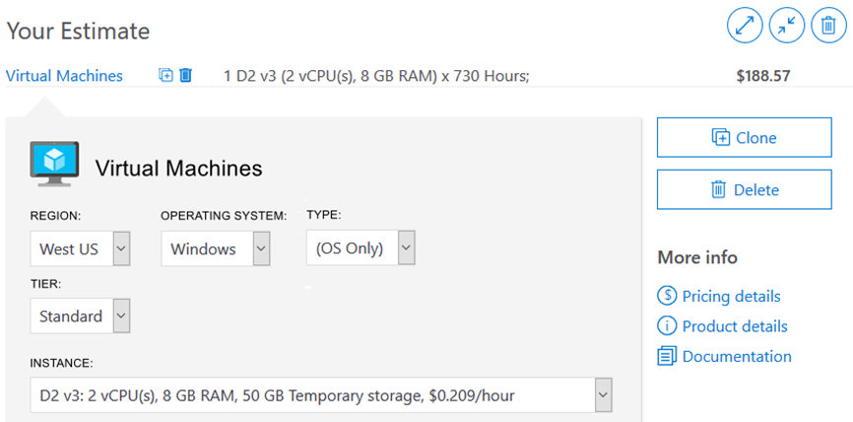
Pricing Calculator
The Pricing Calculator is a tool that helps you estimate the cost of Azure products. The options that you can configure in the Pricing Calculator vary between products, but basic configuration options include:
Region
Tier
Billing options
Support options
Programs and offers
Azure dev/test pricing

Slide 67
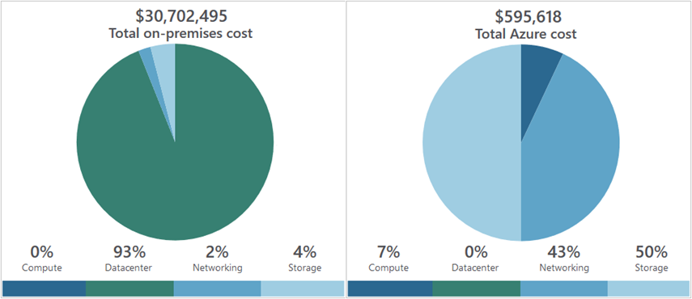
Total Cost of Ownership (TCO) Calculator
A tool to estimate cost savings you can realize by migrating to Azure.
A report compares the costs of on-premises infrastructures with the costs of using Azure products and services in the cloud.

Slide 68
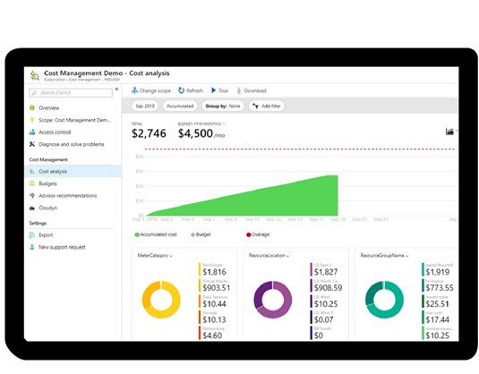
Azure Cost Management
Reporting – billing reports
Data enrichment
Budgets – set spend budget
Alerting – when cost exceed limits
Recommendation – cost recommendations

Slide 69
Tags
Provides metadata for your Azure resources.
Logically organizes resources into a taxonomy.
Consists of a name-value pair.
Very useful for rolling up billing information.
OR
owner: joe
department: marketing
environment: production
cost-center: marketing

Slide 70
3.B. Tools for Governance and Compliance
Azure Blueprints
Azure Policy
Resource Locks
Service Trust Portal

Slide 71

Azure Blueprints
Azure Blueprints makes it possible for development teams to rapidly build and stand up new environments. Development teams can quickly build trust through organizational compliance with a set of built-in components (such as networking) in order to speed up development and delivery.
Role Assignments
Policy Assignments
Azure Resource Manager Templates
Resource Groups

Slide 72

Azure Policy
Azure Policy helps to enforce organizational standards and to assess compliance at-scale. Provides governance and resource consistency with regulatory compliance, security, cost, and management.
Evaluates and identifies Azure resources that do not comply with your policies.
Provides built-in policy and initiative definitions, under categories such as Storage, Networking, Compute, Security Center, and Monitoring.

Slide 73
Resource locks
Protect your Azure resources from accidental deletion or modification.
Manage locks at subscription, resource group, or individual resource levels within Azure Portal.
Lock Types | Read | Update | Delete
DeleteLock | Yes | Yes | No
ReadOnly | Yes | No | No

Slide 74
3.C. Tools for Managing and Deploying Azure Resources
Azure Portal
Azure Cloud Shell
Azure Arc
Azure Resource Manager

Slide 75


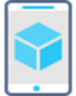




Management Tools in Azure
Azure Portal
Azure PowerShell
Command-Line Interface (CLI)
Azure Mobile App
Azure REST API
Azure Cloud Shell
Azure Resource Manager (ARM)

Slide 76
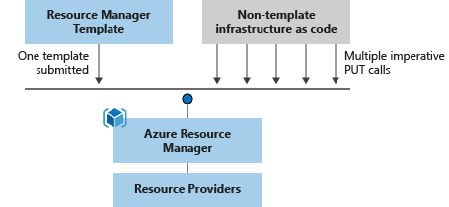
Azure Resource Manager (ARM) templates
Azure Resource Manager (ARM) templates are JavaScript Object Notation (JSON) files that can be used to create and deploy Azure infrastructure without having to write programing commands.
Declarative syntax
Repeatable results
Orchestration
Modular files
Built-in validation
Exportable code

Slide 77
3.D. Monitoring Tools in Azure
Azure Advisor
Azure Service Health
Azure Monitor including Log Analytics, Azure Monitor Alerts, and Application Insights

Slide 78

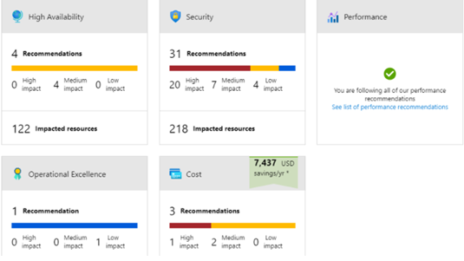
Azure Advisor
Azure Advisor analyzes deployed Azure resources and makes recommendations based on best practices to optimize Azure deployments.
Reliability
Security
Performance
Cost
Operational Excellence
© Copyright Microsoft Corporation. All rights reserved.

Slide 79

Azure Monitor
Azure Monitor maximizes the availability and performance of applications and services by collecting, analyzing, and acting on telemetry from cloud and on-premises environments.
Application Insights
Log Analytics
Smart Alerts
Automation Actions
Customized Dashboards

Slide 80
Useful Resources
Microsoft Learn | Microsoft Docs
Learn TV | Microsoft Docs
Azure | Tags | Channel 9 (msdn.com)
Microsoft Azure – YouTube
Welcome | Azure Tips and Tricks (microsoft.github.io)
Azure Blog and Updates | Microsoft Azure
Microsoft Certifications | Microsoft Docs

Slide 81
THANK YOU

